Slide 1
Stock Price Prediction Using ML
CSMSS
Chh. Shahu College of Engineering
Department of Computer Science & Engineering
Year 2022-23
Group Member : 1. Vaibhav Dagwal (CS3234)
2. Vaishnavi Kharbal(CS3238)
Guide name:
Prof. V. U. Gaikwad

Slide 2
Introduction
Time Series forecasting & modelling plays an important role in data analysis. Time series analysis is a specialized branch of statistics used extensively in fields such as Econometrics & Operation Research. Time Series is being widely used in analytics & data science.
Stock prices are volatile in nature and price depends on various factors. The main aim of this project is to predict stock prices using Long Short Term Memory (LSTM) with Least mean squares (LMS) Algorithm.

Slide 3
Literature Survey
1) Study on the prediction of stock price based on the associated network model of LSTM
The prediction methods can be roughly divided into two categories, statistical methods and artificial intelligence methods. Statistical methods include logistic regression model, ARCH model, etc. Artificial intelligence methods include multi-layer perceptron, convolutional neural network, naive Bayes network, back propagation network, single-layer LSTM, support vector machine, recurrent neural network, etc. They used Long short-term memory network (LSTM).
Long short‑term memory network:
Long short-term memory network (LSTM) is a particular form of recurrent neural network (RNN).
Working of LSTM:
LSTM is a special network structure with three “gate” structures. Three gates are placed in an LSTM unit, called input gate, forgetting gate and output gate. While information enters the LSTM’s network, it can be selected by rules. Only the information conforms to the algorithm will be left, and the information that does not conform will be forgotten through the forgetting gate.

Slide 4
Literature Survey
2) An innovative neural network approach for stock market prediction
An innovative neural network approach for stock market prediction Xiongwen Pang · Yanqiang Zhou· Pan Wang · Weiwei Lin · Victor Chang
Used Long Short-term Memory (LSTM) with embedded layer and the LSTM neural network with automatic encoder.
LSTM is used instead of RNN to avoid exploding and vanishing gradients.
In this project python is used to train the model, MATLAB is used to reduce dimensions of the input. MySQL is used as a dataset to store and retrieve data.
The historical stock data table contains the information of opening price, the highest price, lowest price, closing price, transaction date, volume and so on.
The accuracy of this LSTM model used in this project is 57%.

Slide 5
Literature Survey
3) Stock Market Prediction Using Machine Learning
The research work done by V Kranthi Sai Reddy Student, ECM, Sreenidhi Institute of Science and Technology, Hyderabad, India. In the finance world stock trading is one of the most important activities. Stock market prediction is an act of trying to determine the future value of a stock other financial instrument traded on a financial exchange. This paper explains the prediction of a stock using Machine Learning. The technical and fundamental or the time series analysis is used by the most of the stockbrokers while making the stock predictions.
The programming language is used to predict the stock market using machine learning is Python. In this context this study uses a machine learning technique called Support Vector Machine (SVM) to predict stock prices for the large and small capitalizations and in the three different markets, employing prices with both daily and up-to-the-minute frequencies.

Slide 6
Requirements Analysis
Functional requirements
Functional requirements describe what the software should do (the functions). Think about the core operations.
Because the “functions” are established before development, functional requirements should be written in the future tense. In developing the software for Stock Price Prediction, some of the functional requirements could include:
The software shall accept the tw_spydata_raw.csv dataset as input.
The software should shall do pre-processing (like verifying for missing data values) on input for model training.
The software shall use LSTM ARCHITECTURE as main component of the software.
It processes the given input data by producing the most possible outcomes of a CLOSING STOCK PRICE.

Slide 7
Non-Functional requirements
Product properties
Usability: It defines the user interface of the software in terms of simplicity of understanding the user interface of stock prediction software, for any kind of stock trader and other stakeholders in stock market.
Efficiency: maintaining the possible highest accuracy in the closing stock prices in shortest time with available data.
Performance: It is a quality attribute of the stock prediction software that describes the responsiveness to various user interactions with it.

Slide 8
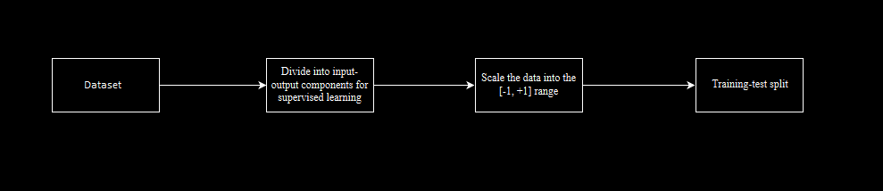
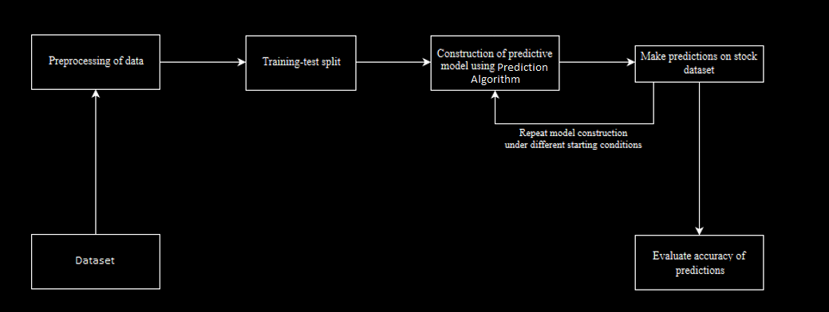
System Architecture
1) Preprocessing of data:
2) Overall Architecture:

Slide 9
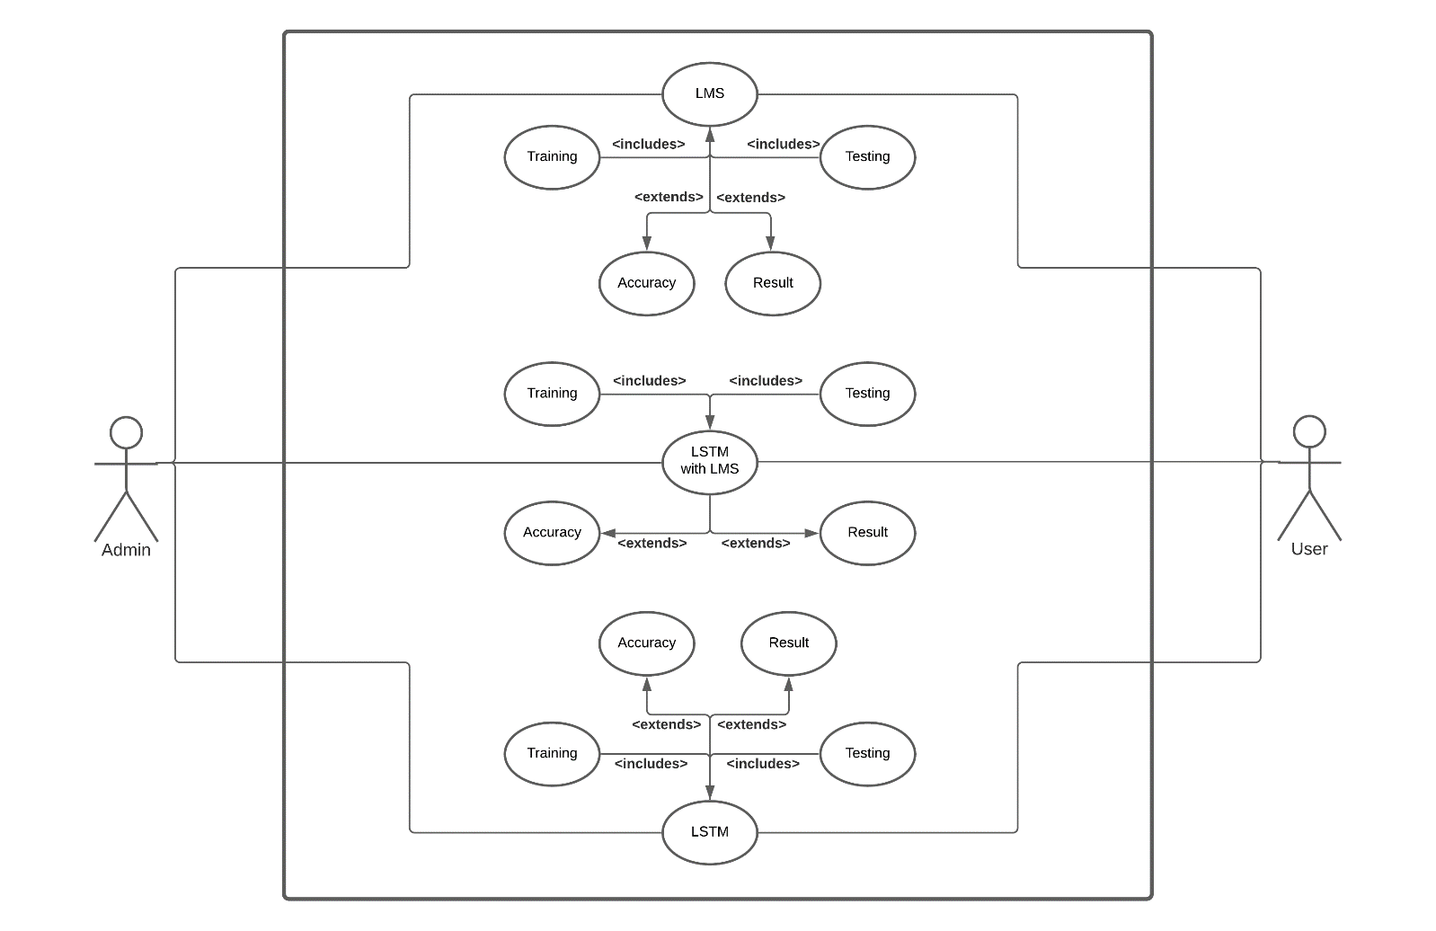
UML Diagrams
Use Case Diagram

Slide 10
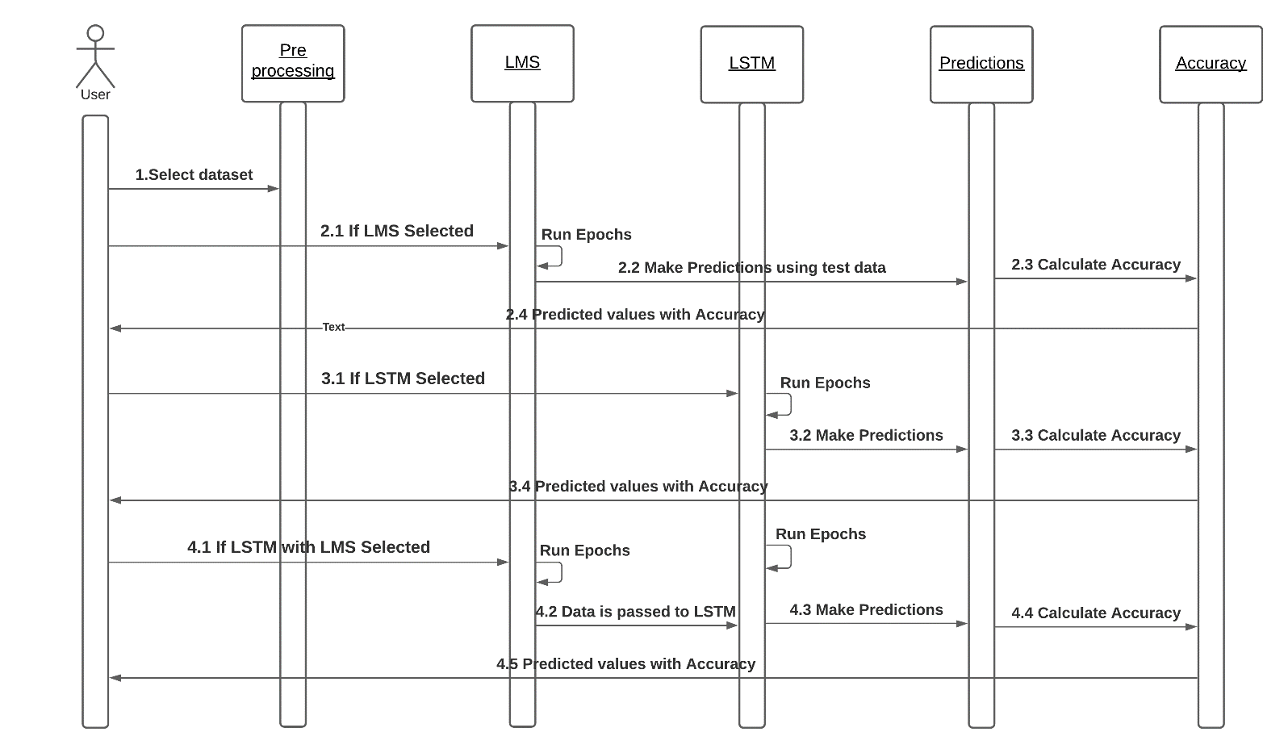
Sequence Diagram

Slide 11
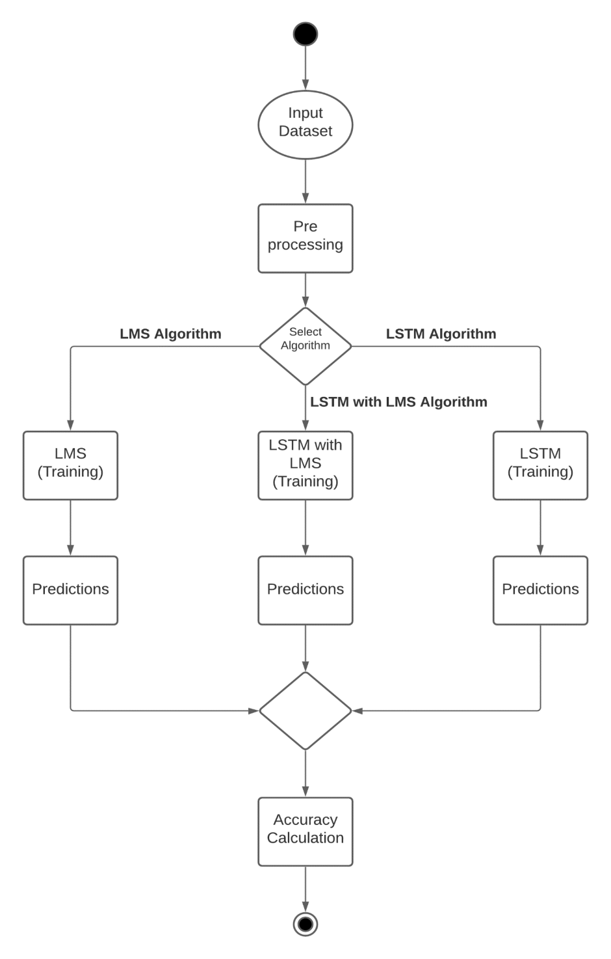
Activity Diagram

Slide 12
System Implementation
The prediction methods can be roughly divided into two categories, statistical methods and artificial intelligence methods. Statistical methods include logistic regression model, ARCH model, etc. Artificial intelligence methods include multi-layer perceptron, convolutional neural network, naive Bayes network, back propagation network, single-layer LSTM, support vector machine, recurrent neural network, etc. They used Long short-term memory network (LSTM).

Slide 13
Long short-term memory network
Long short-term memory network (LSTM) is a particular form of recurrent neural network (RNN).
Working of LSTM:
LSTM is a special network structure with three “gate” structures. Three gates are placed in an LSTM unit, called input gate, forgetting gate and output gate. While information enters the LSTM’s network, it can be selected by rules. Only the information conforms to the algorithm will be left, and the information that does not conform will be forgotten through the forgetting gate.
The experimental data in this paper are the actual historical data downloaded from the Internet. Three data sets were used in the experiments. It is needed to find an optimization algorithm that requires less resources and has faster convergence speed.

Slide 14
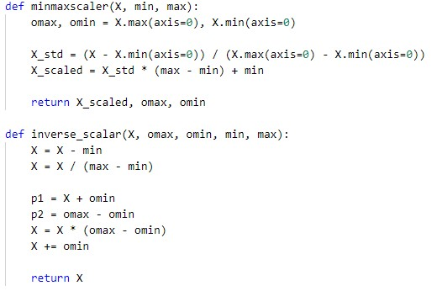
Coding

Slide 15
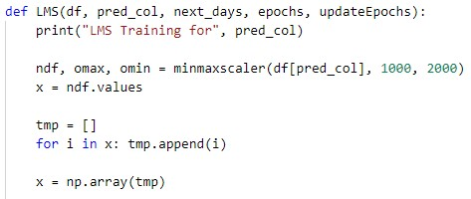
LMS function :-

Slide 16
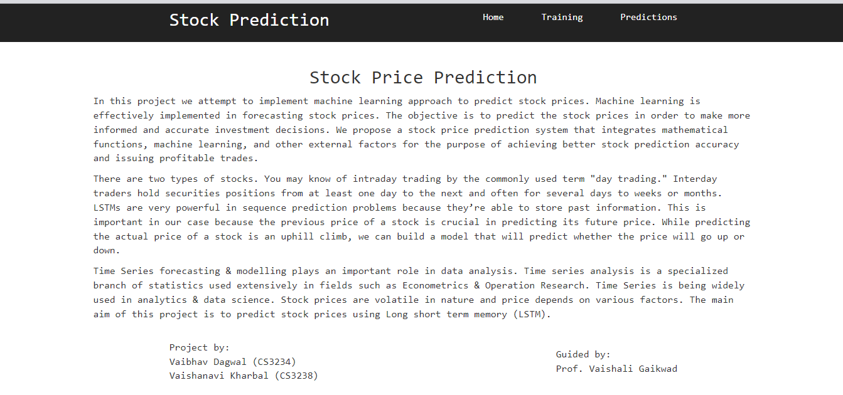
Snapshots

Slide 17
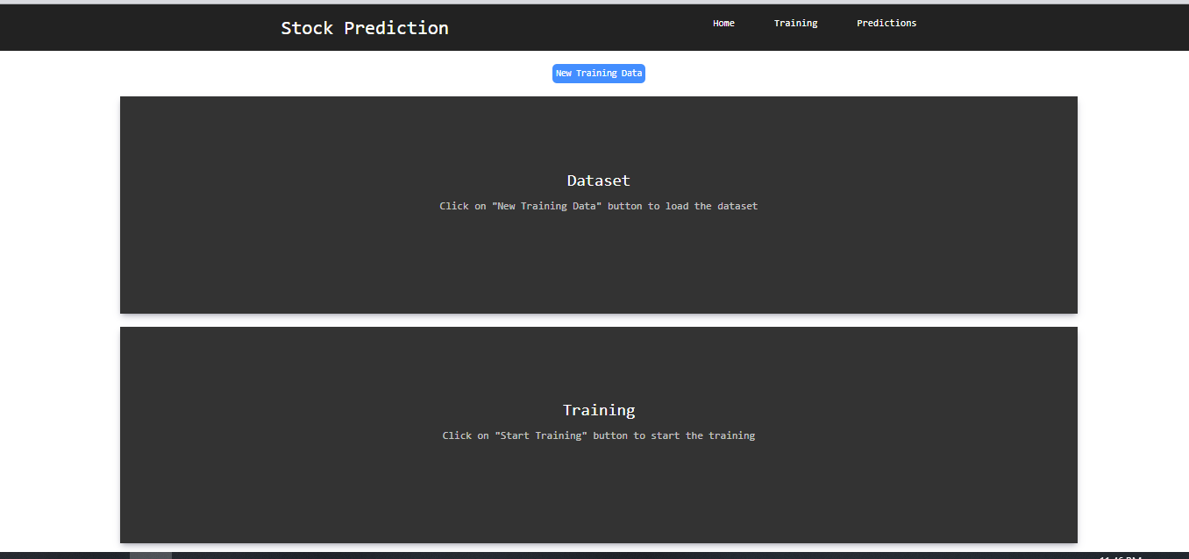
Selection of data :-

Slide 18
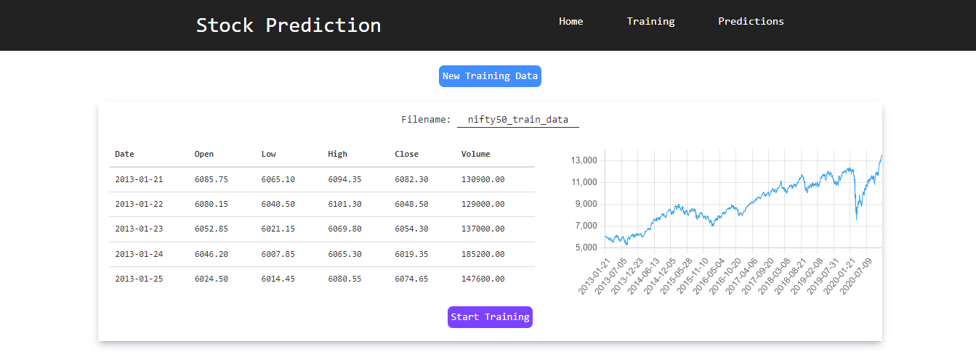
Training Data :-

Slide 19
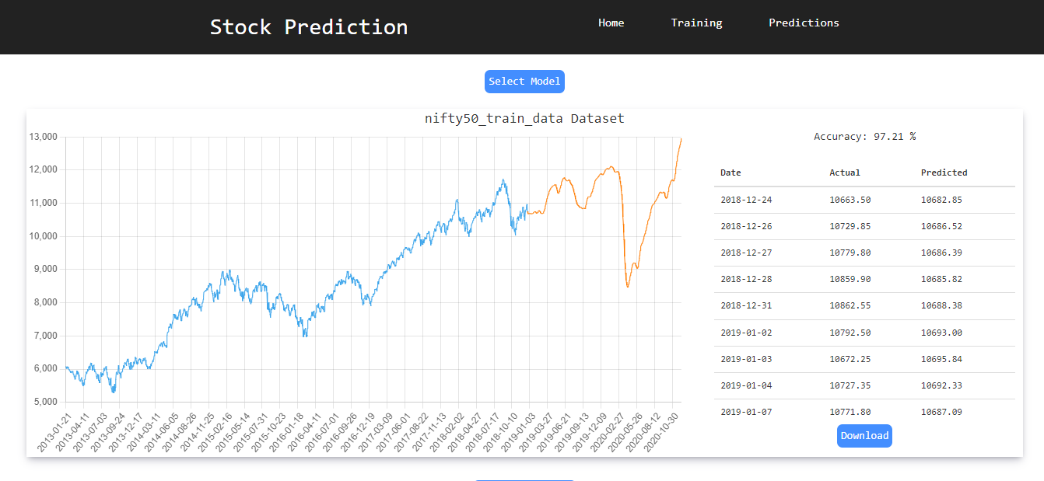
Output from model :-

Slide 20
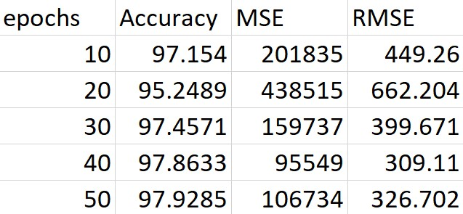
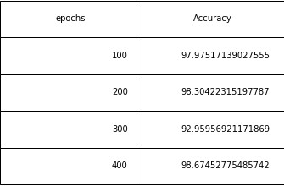
Results
-Epochs for Nifty50 Dataset using LSTM

Slide 21
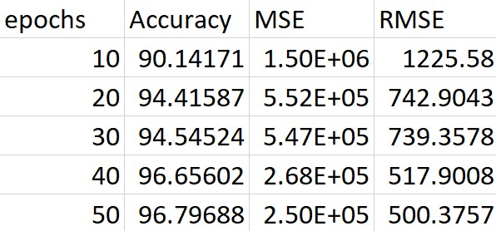
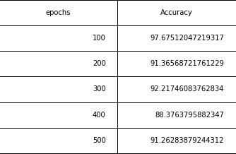
- Epochs for Nifty50 Dataset using LSTM with LMS

Slide 22
Conclusion
We are predicting the closing stock price of any given organization, we have developed an application for predicting close stock price using LSTM algorithm. We have used datasets belonging to Google, Nifty50, TCS, Infosys and Reliance Stocks and achieved above 93% accuracy for these datasets. In the future, we can extend this application for predicting cryptocurrency trading and also, we can add sentiment analysis for better predictions.

Slide 23
Future Scope
Future scope of this project will involve adding more parameters and factors like the financial ratios, multiple instances, etc. The more the parameters are taken into account more will be the accuracy. The algorithms can also be applied for analyzing the contents of public comments and thus determine patterns/relationships between the customer and the corporate employee. The use of traditional algorithms and data mining techniques can also help predict the corporation‟s performance structure as a whole.

Slide 24
References
[1] Stock Price Prediction Using LSTM on Indian Share Market by Achyut Ghosh, Soumik Bose1, GiridharMaji, Narayan C. Debnath, Soumya Sen
[2] S. Selvin, R. Vinayakumar, E. A. Gopalkrishnan, V. K. Menon and K. P. Soman - Stock price predictionusing LSTM, RNN and CNN-sliding window model - 2017.
[3] Murtaza Roondiwala, Harshal Patel, Shraddha Varma, “Predicting Stock Prices Using LSTM” in Undergraduate Engineering Students, Department of Information Technology, Mumbai University, 2015.
[4] Xiongwen Pang, Yanqiang Zhou, Pan Wang, Weiwei Lin, “An innovative neural network approach for stock market prediction”, 2018
[5] Ishita Parmar, Navanshu Agarwal, Sheirsh Saxena, Ridam Arora, Shikhin Gupta, Himanshu Dhiman, Lokesh Chouhan Department of Computer Science and Engineering National Institute of Technology, Hamirpur – 177005, INDIA - Stock Market Prediction Using Machine Learning.

Slide 25
[6] Pranav Bhat Electronics and Telecommunication Department, Maharashtra Institute of Technology, Pune. Savitribai Phule Pune University - A Machine Learning Model for Stock Market Prediction.
[7] Anurag Sinha Department of computer science, Student, Amity University Jharkhand Ranchi, Jharkhand (India), 834001 - Stock Market Prediction Using Machine Learning.
[8] V Kranthi Sai Reddy Student, ECM, Sreenidhi Institute of Science and Technology, Hyderabad, India - Stock Market Prediction Using Machine Learning
[9] Asset Durmagambetov currently works at the mathematics, CNTFI- 'The Riemann HypothesisMillennium Prize Problems' - stock market predictions.
[10] Mariam Moukalled Wassim El-Hajj Mohamad Jaber Computer Science Department American University of Beirut - Automated Stock Price Prediction Using Machine Learning.

